Slide 1
CSP2108: Introduction to Mobile Applications Development
Week 6: Interaction

Slide 2
Topics this week
User Interface Design for Mobile Apps

Slide 3
User Interface Design for Mobile
Most mobile apps use a GUI (graphical user interface)
All the usual UI design principles apply
Extra considerations
Small screen space
Slow download speed
Lack of keyboard/pointer

Slide 4
Some UI design principles
Structure
related things grouped together
similar things looks similar
dissimilar things look different
Simplicity
common tasks should be easy
Visibility
things needed for the task should be visible
extraneous/redundant things should not be

Slide 5
Some UI design principles
Feedback
Keep the user informed of progress/changes/errors
Tolerance
prevent errors where possible
reduce cost of mistakes
allow undo
allow reasonable actions
Reuse components and behaviours
promotes consistency
reduces the need to remember/rethink
Notes:
http://blog.careerfoundry.com/ui-design/how-to-design-a-mobile-app-using-user-interface-design-principles

Slide 6
Some mobile UI principles
Be focused – more is not better
Be responsive – provide feedback, be fast if possible
Thumbs – are the default. Design for thumbs and fat fingers.
Content – minimise checkboxed/buttons/sliders etc
Controls go at the bottom (so you can see the screen when using them)
Avoid scrolling where possible
Use existing navigation models
Notes:
http://www.creativebloq.com/mobile/10-principles-mobile-interface-design-4122910

Slide 7
Some mobile UI principles
Keyboards
use right ones (e.g. text/phone/numbers)
use right options (auto-complete? auto-correct?)
support landscape if lots of typing
Modal alerts
only use if really needed e.g. serious error
OK for confirmations
Launch
start where left off last time if possible
loading screen should be “content-less”
Notes:
http://www.creativebloq.com/mobile/10-principles-mobile-interface-design-4122910

Slide 8
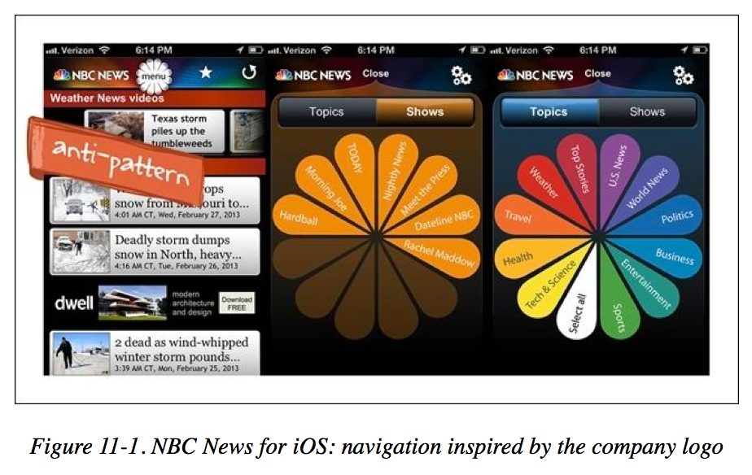
Some mobile antipatterns (things not to do)
Novel design ideas – tend to be confusing
Notes:
Mobile Design Pattern Gallery: UI Patterns for Smartphone Apps, Edition 2
Theresa Neil

Slide 9
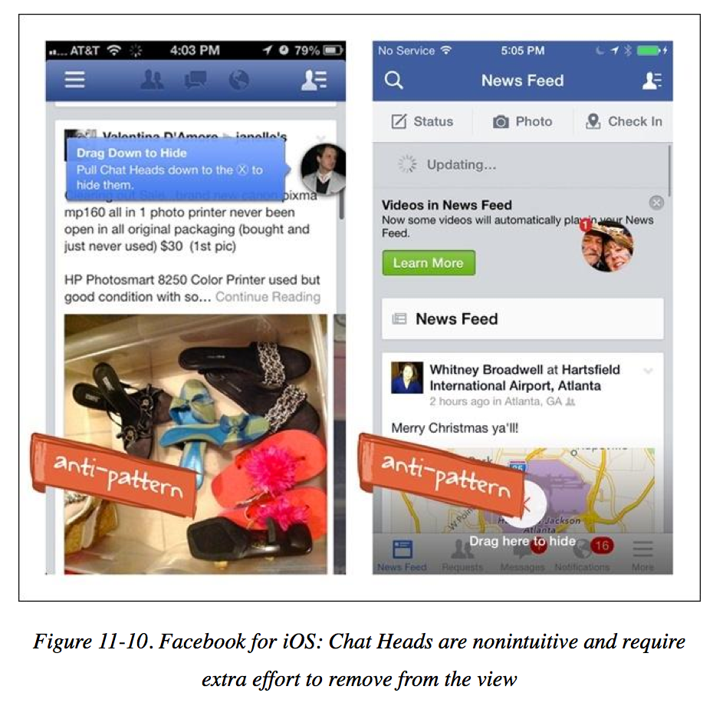
Some mobile antipatterns (things not to do)
Needless Complexity
Notes:
Mobile Design Pattern Gallery: UI Patterns for Smartphone Apps, Edition 2
Theresa Neil

Slide 10
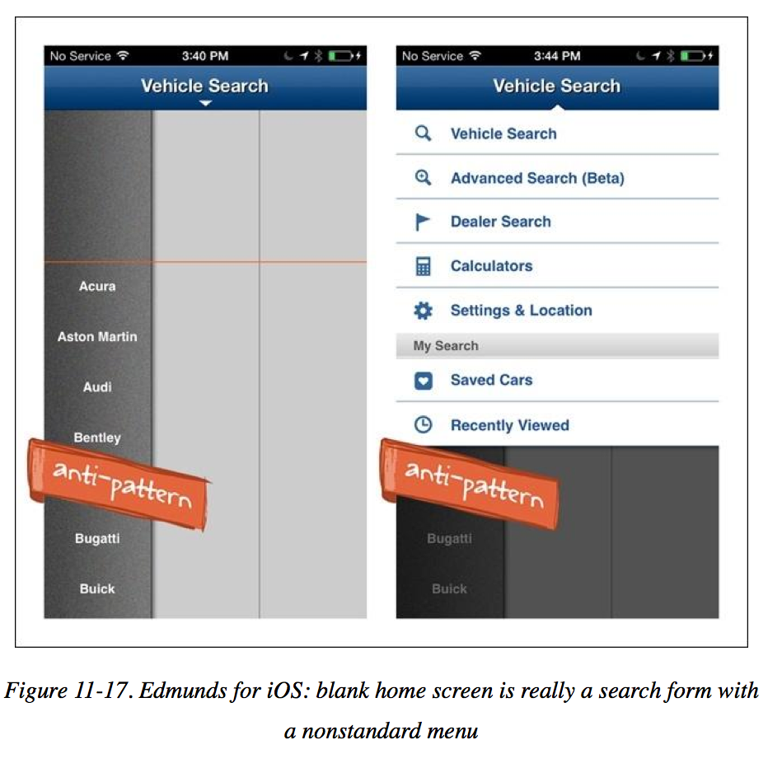
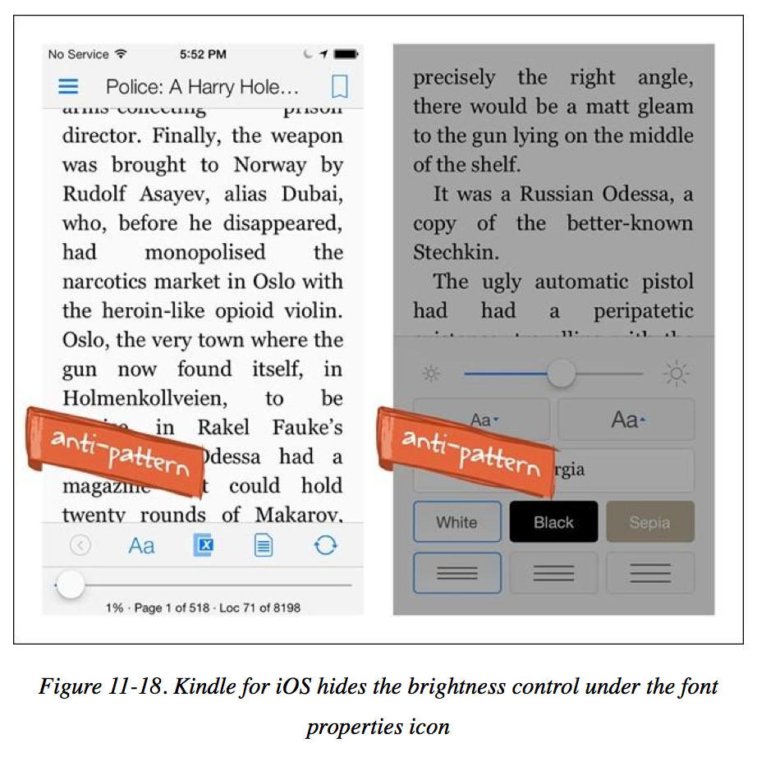
Some mobile antipatterns (things not to do)
Metaphor Mismatch
Notes:
Mobile Design Pattern Gallery: UI Patterns for Smartphone Apps, Edition 2
Theresa Neil

Slide 11
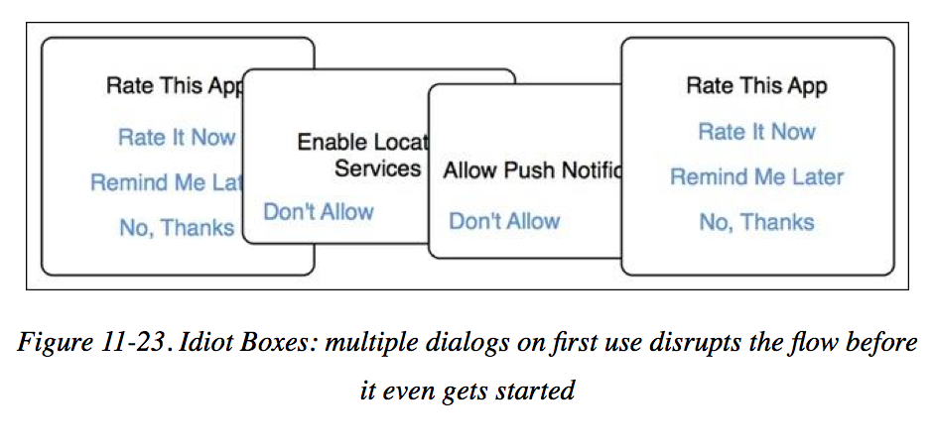
Some mobile antipatterns (things not to do)
Idiot Boxes
Notes:
Mobile Design Pattern Gallery: UI Patterns for Smartphone Apps, Edition 2
Theresa Neil

Slide 12
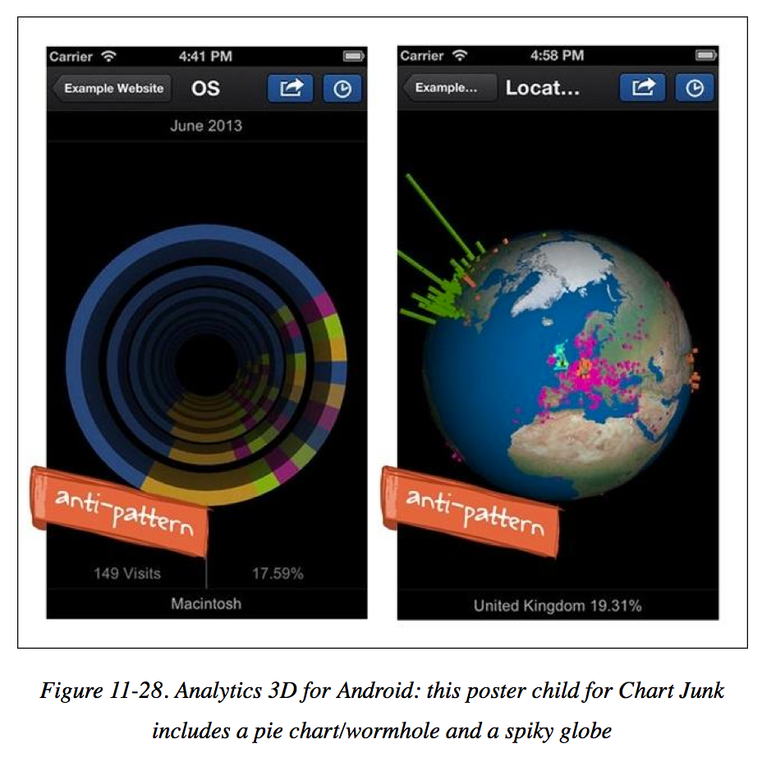
Some mobile antipatterns (things not to do)
Chart Junk
Notes:
Mobile Design Pattern Gallery: UI Patterns for Smartphone Apps, Edition 2
Theresa Neil

Slide 13
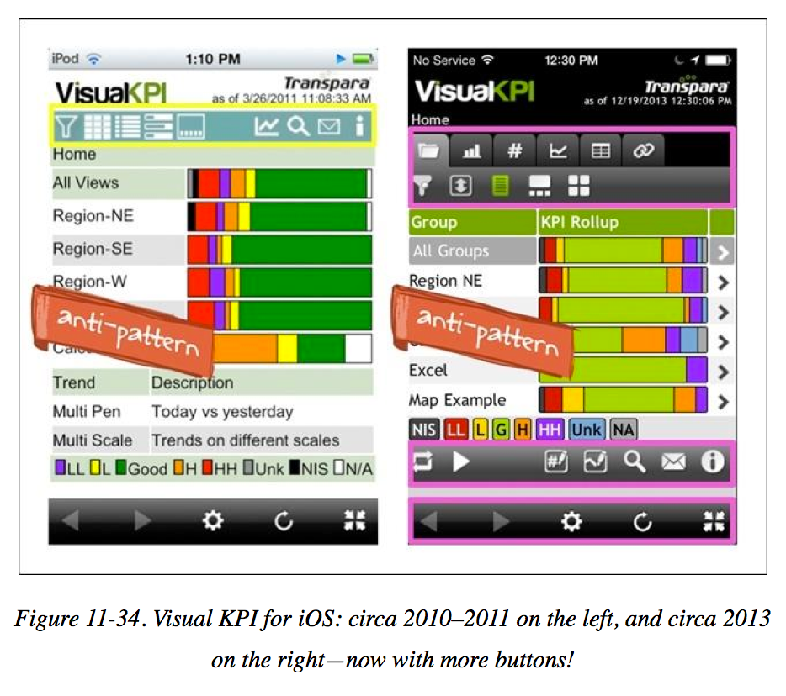
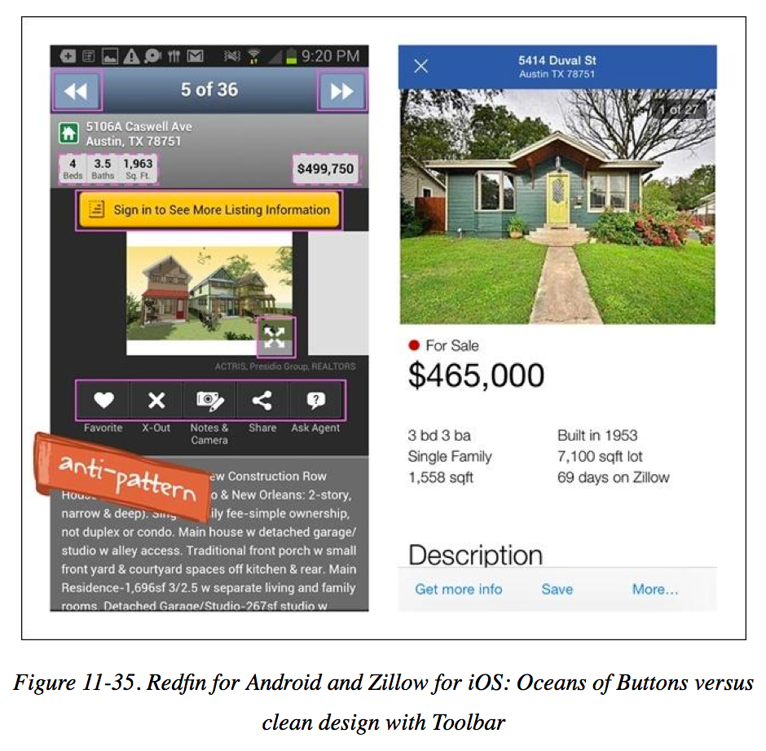
Some mobile antipatterns (things not to do)
Oceans of buttons
Notes:
Mobile Design Pattern Gallery: UI Patterns for Smartphone Apps, Edition 2
Theresa Neil

Slide 14
Platform specific guidelines/standards
Sometimes there are platform-specific standards to be aware of e.g.
iOS: https://developer.apple.com/ios/human-interface-guidelines/
Windows mobile: https://msdn.microsoft.com/en-us/library/bb158602.aspx
Amazon Fire TV: https://developer.amazon.com/public/solutions/devices/fire-tv/docs/design-and-user-experience-guidelines
Android: https://developer.android.com/guide/practices/ui_guidelines/index.html
These often include useful design examples

